Slide 1
Jana
Lab meeting
2020-04-02
@HighlanderLab

Slide 2
Agenda
AlphaPart
Resource allocation (if there is time)

Slide 3

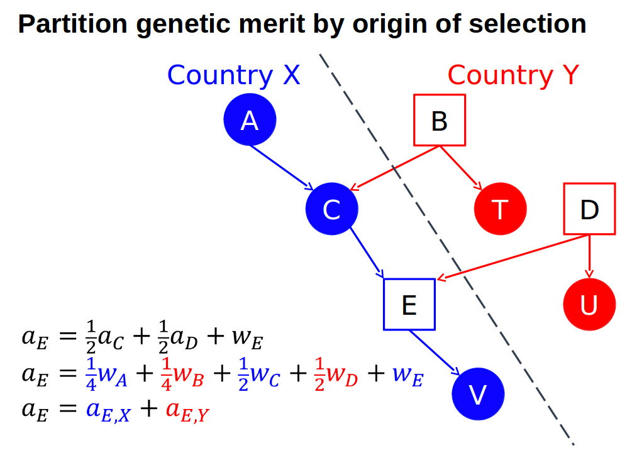
AlphaPart
R-package (CRAN)
Partitioning of genetic trend
(García-Cortés et al., 2008)
BY paths of information
PA
MST

Slide 4
Paper
Submitted to Animal → rejected (not in the scope)
“ limited alignment of the submission focus, results and interpretation to the scope of Animal encompassing examples”
Resubmit to GSE as a Software paper
Minor changes → discuss the software

Slide 5
AlphaPart
Does it work for gEBV?
EBV = w₁*PA + w₂*YD + w₃*PC; w₁ + w₂ + w₃ = 1
parent MST
average

Slide 6
AlphaPart
Does it work for gEBV?
EBV = w₁*PA + w₂*YD + w₃*PC; w₁ + w₂ + w₃ = 1
parent MST
average
Genotype information
gEBV = w₁*PA + w₂*YD + w₃*PC + w₄*GI; w₁ + w₂ + w₃ + w₄ = 1
gEBV = w₁*PA + w₂*YD + w₃*PC + w₄*DGV - w₄*PP
Parent average
Parent average of the DGV

Slide 7
AlphaPart
Does it work for gEBV?
EBV = w₁*PA + w₂*YD + w₃*PC; w₁ + w₂ + w₃ = 1
parent MST
average
Genotype information
gEBV = w₁*PA + w₂*YD + w₃*PC + w₄*GI; w₁ + w₂ + w₃ + w₄ = 1
gEBV = w₁*PA + w₂*YD + w₃*PC + w₄*DGV - w₄*PP
Parent average
Parent average of the DGV
MST?

Slide 8
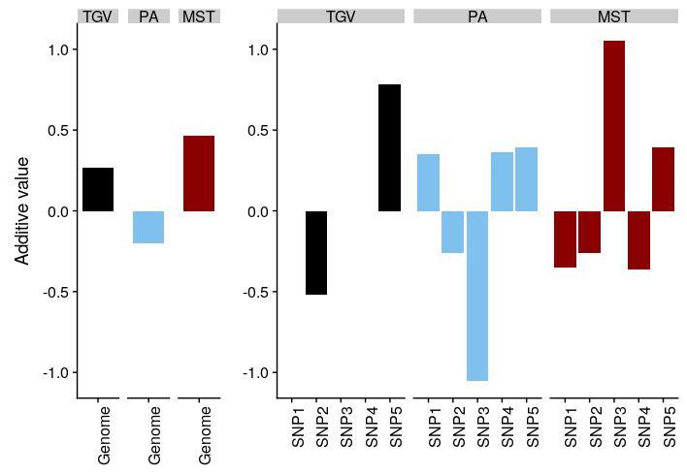
Genomic AlphaPart
1. “loci unpacking”
Which genome regions drive genetic gain
Sources of haplotypes / alleles

Slide 9
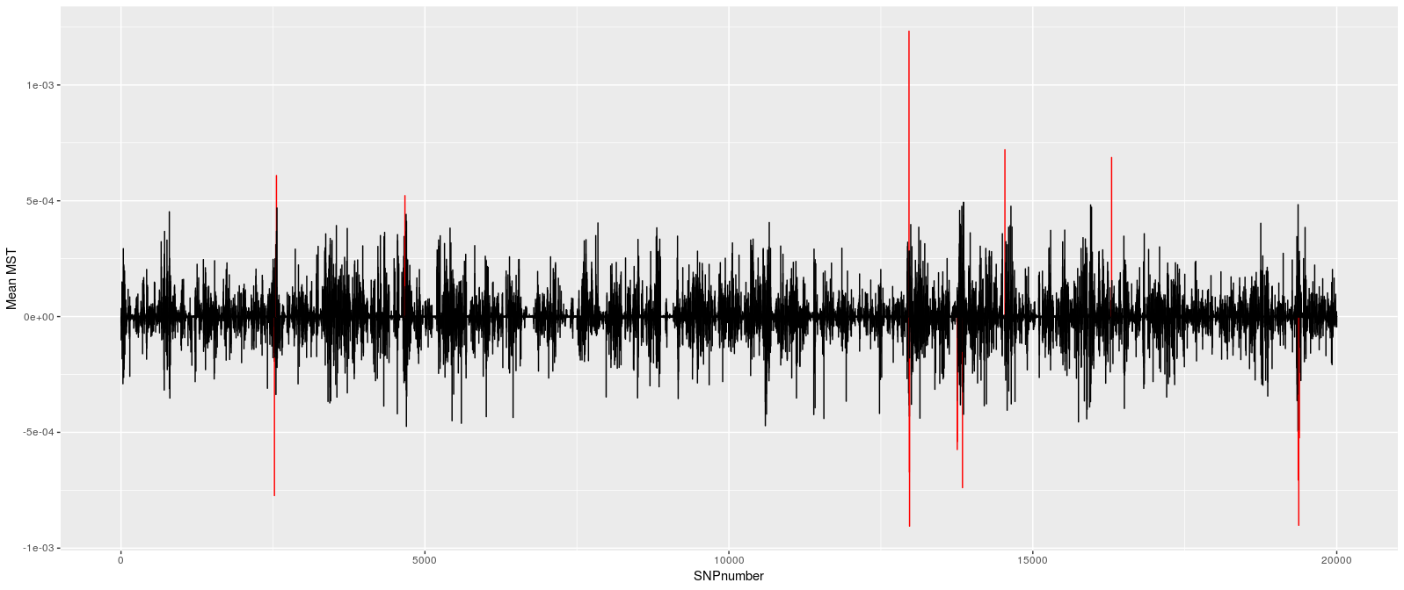
Genomic AlphaPart
1. “loci unpacking”

Slide 10
INPUT DATA
OUTPUT DATA
Arrays
Ped
IId
FId
MId
Path
BVs
IId
Trait
BV
Genotypes
Trait 2
Individual
Loci
Trait
Samples (MC)
Trait 1
SNP1 SNP2 SNP3 ...
AddEff
Trait
SNP
Eff
ID₁
ID₂
ID₃
...
MST_{1,1}
MST_{2,1}
MST_{3.1}
...
Geno
IId
SNP
Geno
Haplotypes
Trait 2
Individual
Loci
Trait
Path
Samples (MC)
Trait 1
Haplo
IId
SNP
Parent
Haplo
Path2
Path1
SNP1 SNP2 SNP3 ...
ID₁
ID₂
ID₃
...
MST_{1,1}
MST_{2,1}
MST_{3.1}
...

Slide 11
INPUT DATA
OUTPUT DATA
Arrays
Ped
IId
FId
MId
Path
BVs
IId
Trait
BV
Genotypes
Trait 2
Individual
Loci
Trait
Samples (MC)
Trait 1
SNP1 SNP2 SNP3 ...
AddEff
Trait
SNP
Eff
ID₁
ID₂
ID₃
...
MST_{1,1}
MST_{2,1}
MST_{3.1}
...
Geno
IId
SNP
Geno
Haplotypes
Trait 2
Individual
Loci
Trait
Path
Samples (MC)
Trait 1
Haplo
IId
SNP
Parent
Haplo
SNP2
SNP1
Path1 Path2
ID₁
ID₂
ID₃
...
MST_{1,1}
MST_{2,1}
MST_{3.1}
...

Slide 12

Resource allocation
Optimize the investment in a dairy breeding programme
Maximise the return on investment
Repeated phenotype records have diminishing return
Conventional
selection
Phenotypisation
=
=
=
Phenotypisation
Genotypisation
Genomic
selection
=
Phenotypisation
Genotypisation

Slide 13
Scenarios
Initial training
population
$phenotye:$genotype
No phenotype records / lactation
1
1:1
1
2
YES
2
5
8
9
10
2:1
1
2
2
5
8
9
10
1:2
1
2
2
5
8
9
10
1
1:1
1
2
NO
2
5
8
9
10
2:1
1
2
2
5
8
9
10
1:2
1
2
2
5
8
9
10

Slide 14
Resource allocation
Aiming to submit to GSE
Figures?

Slide 15
With initial
training population

Slide 16
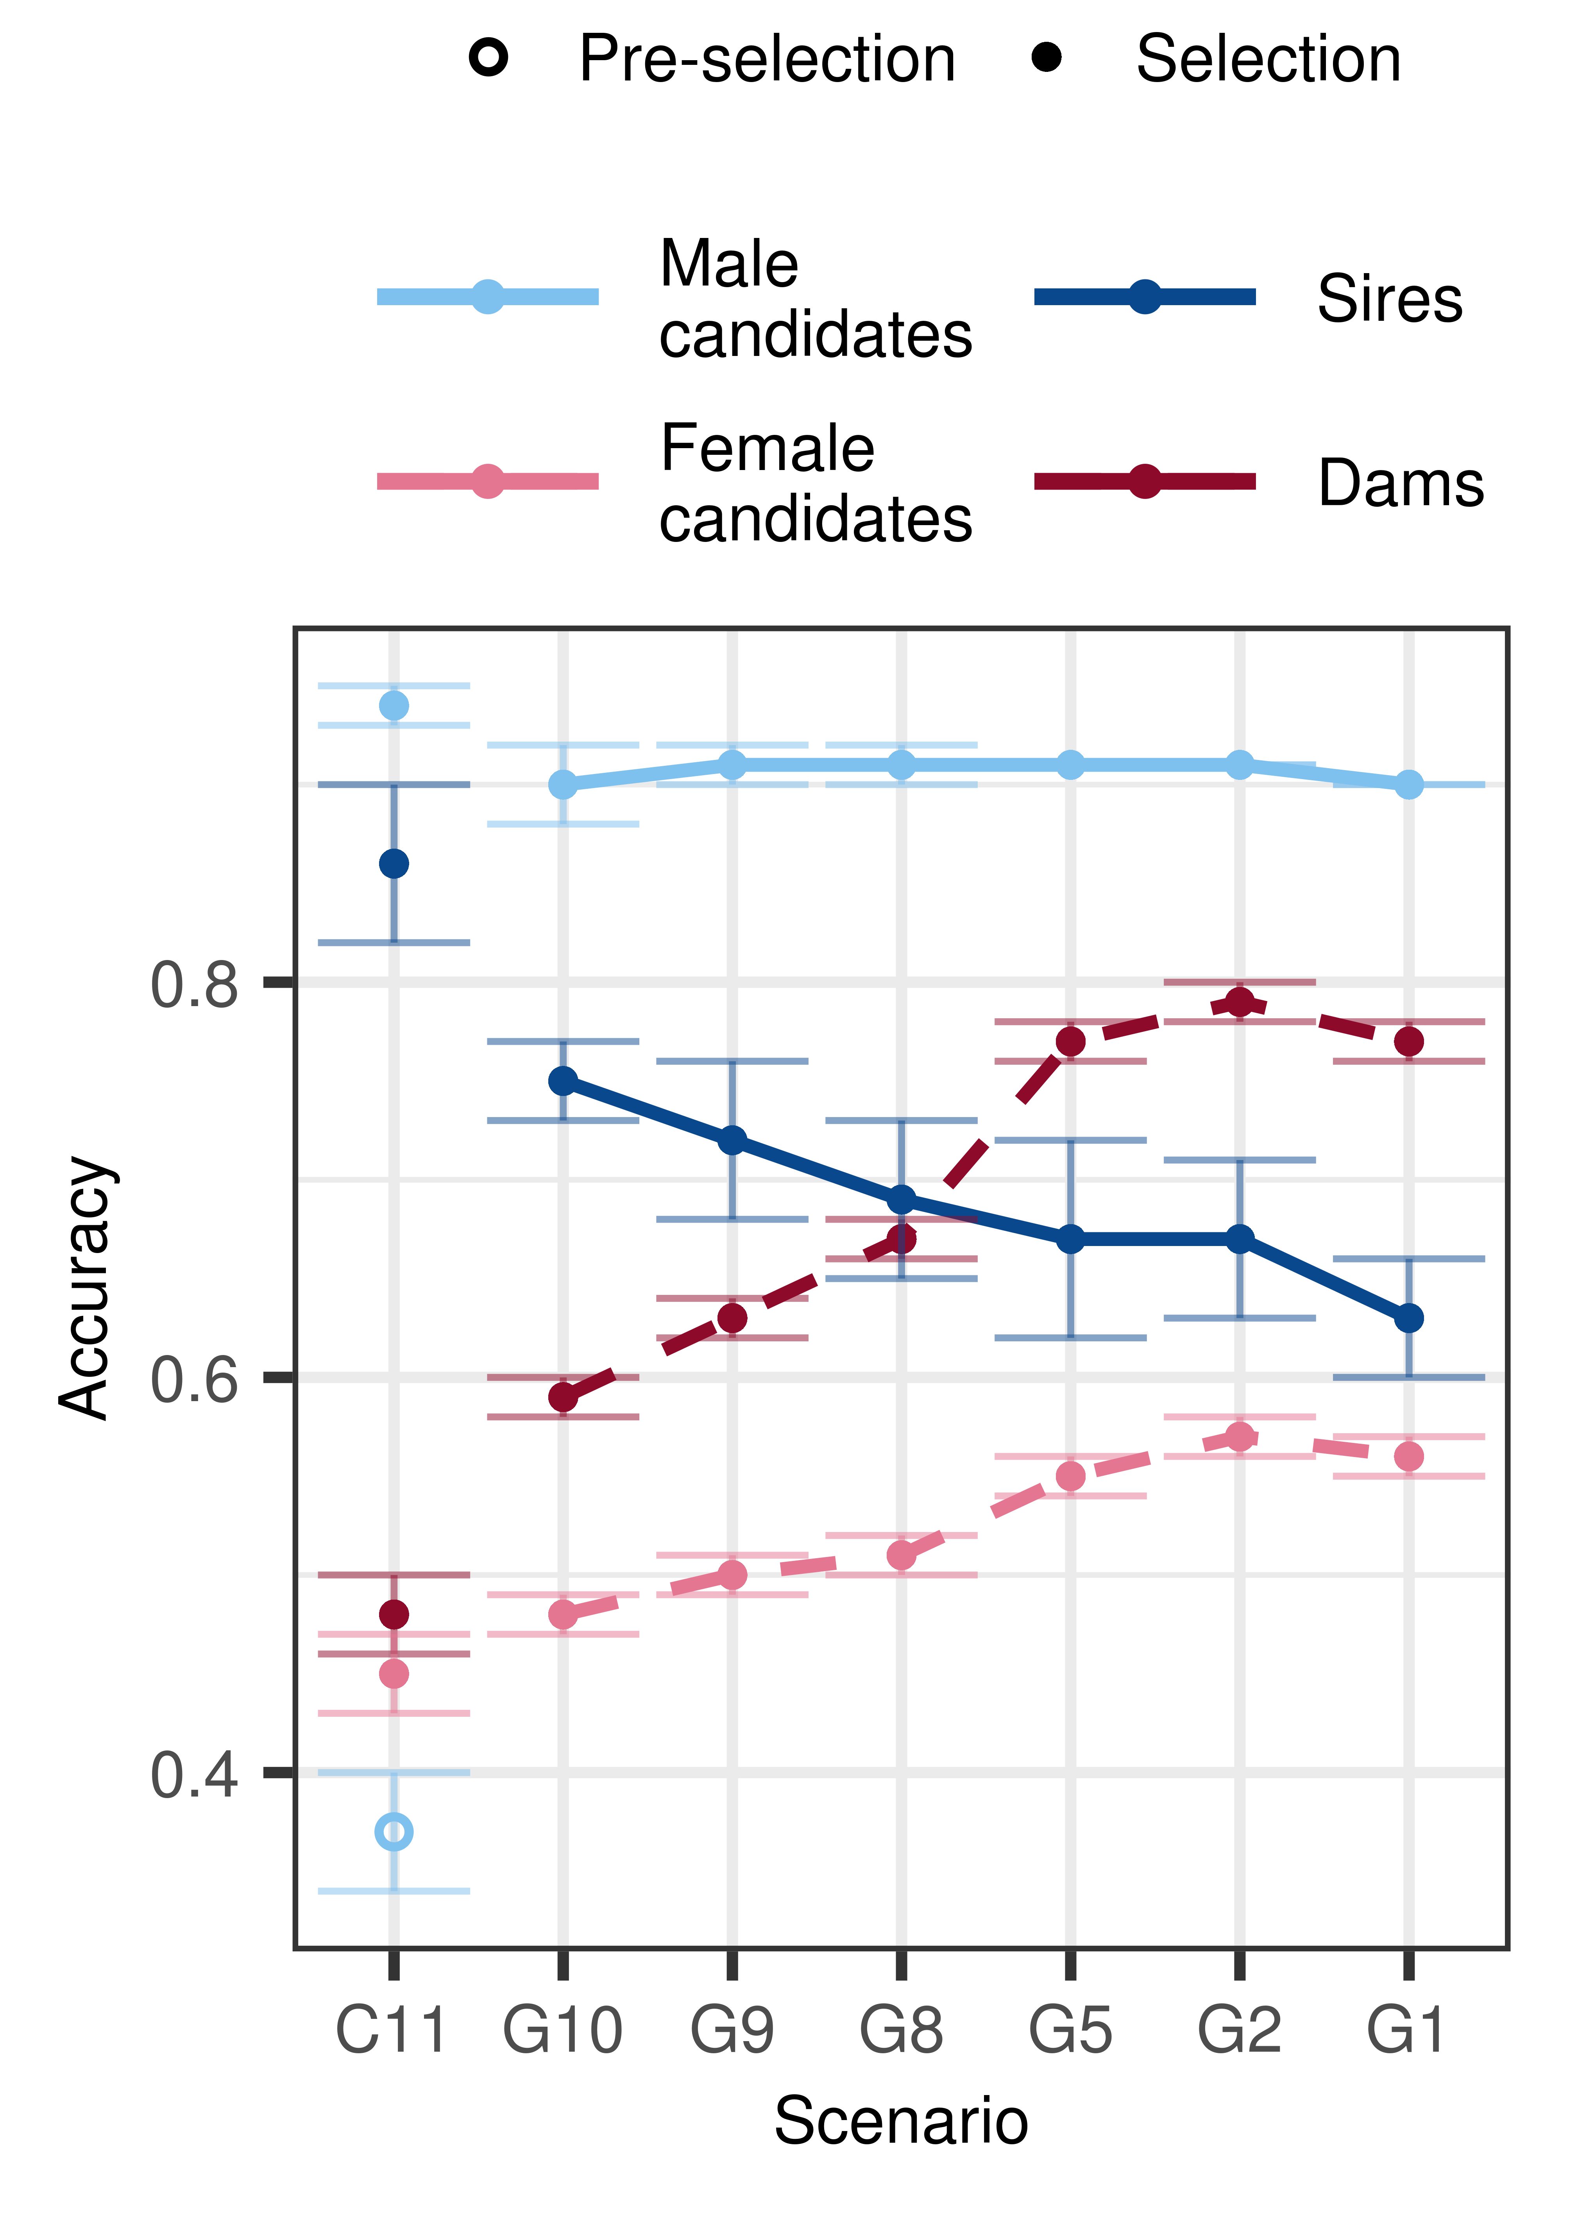

Slide 17
Without initial
training population,
$P:$G=1:1

